Slide 1
JAVASCRIPT

Slide 2
Introduction to JavaScript
JavaScript is a lightweight scripting language aka programming language.
JavaScript is case sensitive.
Brendan Eich creator of JavaScript language in 1995.
Use script tag to include js in html.
<script src = “index.js”></script>
JavaScript v/s EcmaScript.

Slide 3
JavaScript Engine
A JavaScript Engine is a computer program that executes JavaScript code.
JavaScript Engines are developed by web browser vendors,
and every major browser has one.
Firefox – SpiderMonkey.
Chrome – V8.
Microsoft Edge – Chakra.
Safari – JavaScriptCore.

Slide 4
JavaScript Engine WorkFlow

Slide 5
Data Types and Variables
Variables – Variables are containers that you can store values in it.
Syntax :- var name(identifier) = ‘Raj’;(value)
Primitive – Number, String, Boolean, null, undefined. (immutable)
Reference – Object, Arrays, Date, Math, Function.
(mutable)

Slide 6
Operators
Arithmetic Operators : +, -, *, /, %, ++, --
Assignment Operators : =, +=, -=, *=, /=, %=
Comparison Operators : ==, ===, !=, !==, >, <, >=,<=
Conditional (Ternary) Operator : variablename = (condition) ? value1:value2
Ex : var status = (age >= 18) ? “Adult“ : “Minor";
Logical Operators : &&, ||, !
typeof Operator : returns type of a variable, object, function or expression.
Ex : typeof "John“ // returns string
typeof(10) // returns number
Concatenation Operator(+) : used to concatenate strings and variable.

Slide 7
JavaScript Object
The values are written as name : value pairs (name and value separated by a colon).
Ex : var person = {
firstName : “John”,
lastName : “Doe”,
age : 50,
eyeColor : “blue”,
fullName : function() { return this.firstName + " " + this.lastName; }
};
Using new keyword :
var person = new Object(); person.firstName = "John"; person.lastName = "Doe"; person.age = 50; person.eyeColor = "blue";

Slide 8
JavaScript Arrays
An array is a special variable, which can hold more than one value at a time.
Syntax : var array_name = [item1, item2, ...];
Ex : var fruits = [‘Apple’, ‘Banana’, ‘Orange’];
Ex : var employee = [‘John’,45,null,,true]; // multiple data types supported
Accessing values – fruits[0]
Using new keyword
var fruits = new Array(‘Apple’, ‘Banana’, ‘Orange’);
Complex Array
var library = [
{author : ’Bill Gates’ , title : ‘The Road Ahead’ , bookID : 1254 },
{author : ‘Steve Jobs’ , title : ‘Walter Isaacson’ , bookID : 4264 },
{author : ’Suzanne Collins’ , title : ‘Mockingjay : The Final Book of The Hunger Games’ , bookID : 3254 },
];

Slide 9
Date Object
Creating Date Objects
new Date()
Ex : var date = new Date();
new Date(year, month, day, hours, minutes, seconds, milliseconds)
Ex : var date = new Date(2018, 11, 24, 10, 33, 30, 0);
new Date(milliseconds)
Ex : var date = new Date(0); Zero time is January 01, 1970 00:00:00 UTC.
new Date(date string)
Ex : var date = new Date("October 13, 2014 11:13:00");

Slide 10
Date Object Methods
Method | Description
getFullYear() | Get the year as a four digit number (yyyy)
getMonth() | Get the month as a number (0-11)
getDate() | Get the day as a number (1-31)
getHours() | Get the hour (0-23)
getMinutes() | Get the minute (0-59)
getSeconds() | Get the second (0-59)
getMilliseconds() | Get the millisecond (0-999)
getTime() | Get the time (milliseconds since January 1, 1970)
getDay() | Get the weekday as a number (0-6)
Date.now() | Get the time. ECMAScript 5.

Slide 11
Math Object
Math.PI – returns pi value.
Math.round(x) - returns the value of x rounded to its nearest integer.
Math.pow(x , y) - returns the value of x to the power of y.
Math.sqrt(x) - returns the square root of x.
Math.abs(x) - returns the absolute (positive) value of x.
Math.ceil(x) - returns the value of x rounded up to its nearest integer.
Math.floor(x) - returns the value of x rounded down to its nearest integer.
Math.min() and Math.max() - can be used to find the lowest or highest value in a list of arguments.
Math.random() - returns a random number between 0 (inclusive), and 1 (exclusive).

Slide 12
Control Structures, Loops
if, if-else, if else-if, for, switch, while, do-while, continue, break, for-of, for-in, forEach
for loop | forEach | for of | for in
Does not work with object | Does not work with object, only use with arrays | Does not work with object | Works with object and arrays
Does not ignore empty elements | Ignores empty elements | Does not ignore empty elements | Ignores empty elements
break statement is supported | break statement is not supported coz it’s a method | break statement is supported | break statement is supported
Ignores extra properties which does not have index | Ignores extra properties which does not have index | Ignores extra properties which does not have index | Does not ignore extra properties which does not have index
Performance 3 | Performance 4 | Performance 1 | Performance 2

Slide 13
JavaScript Functions
Named Functions :
function funcname( args ) {
//statements
}
Function Expression :
var getName = function( args ) {
//statements
}
IIFE(Immediately Invoked Function Expression) :
(function( args ){
//statements
})();
ES6 Arrow Function :
( args ) => {
//statements
}

Slide 14
Variable Hoisting
Variable hoisting :
Before Hoisting :- After hoisting :-
Variable Hoisting in Function :
Before Hoisting :- After hoisting :-
console.log(hoist);
var hoist = ‘The variable has been hoisted’;
var hoist;
console.log(hoist);
hoist = ‘The variable has been hoisted’;
function hoist() { console.log(message);
var message = ‘Hoisting’
}
hoist();
function hoist() {
var message console.log(message);
message = ‘Hoisting’
}
hoist();

Slide 15
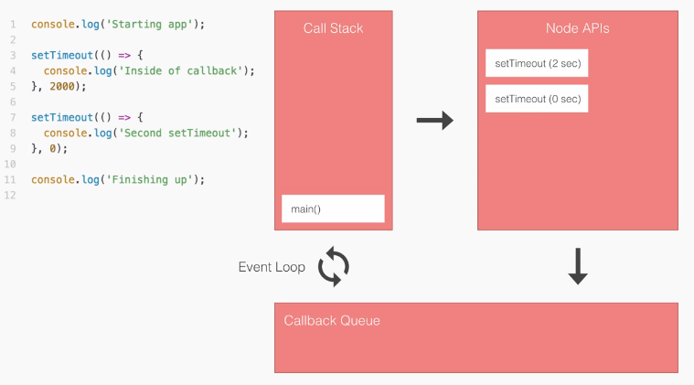
JavaScript Call Stack

Slide 16
Array and String Methods
Array :
Properties -
length
Methods -
forEach(( callback( value, index) )), isArray(), includes( searchElement, fromIndex ), push(items), pop(), shift(), unshift(items), splice(start index, delete count, items),
slice( start index, end index), join( separator ), indexOf( searchElement, fromIndex ), map(( callback( value, index) )), filter(( callback( value, index) ))
String :
Properties -
length
Methods -
toLowerCase(), toUpperCase(), charAt( position ), indexOf( searchString, position ), concat(…strings), includes(search String, start position),replace(search Value, replaceValue),
split( separator, limit), substr( start, length), search(value), trim()

Slide 17
Closures, Callback, Recursion
Closures :
An inner function has always access to the parameters and variables of its outer function, even after the outer function has returned and removed from the stack.
Callback :
A callback function is a function passed into another function as an argument.
A callback function is a function that is to be executed after another function has finished executing – hence the name ‘call back’.
Recursion :
A function calling itself repeatedly until it arrives at a result.

Slide 18
Browser Object Model(BOM)
The Browser Object Model (BOM) allows JavaScript to "talk to" the browser.
Window Object :
The window object is supported by all browsers. It represents the browser's window tab.
Properties :
innerHeight, innerWidth.
Methods :
prompt, alert, confirm, open, close, console.
Location Object :
href, hostname, pathname, protocol, port.
History Object :
back(), forward().

Slide 19
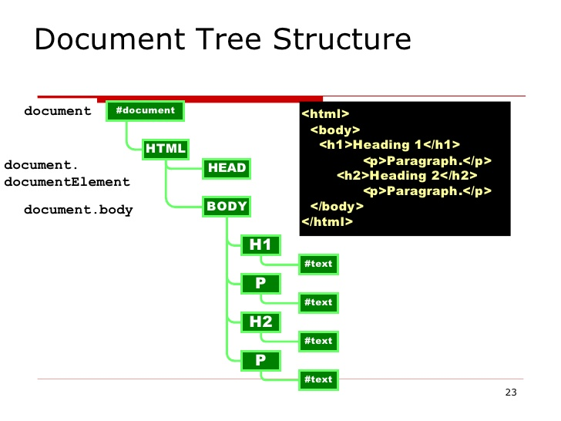
DOM Tree Structure

Slide 20
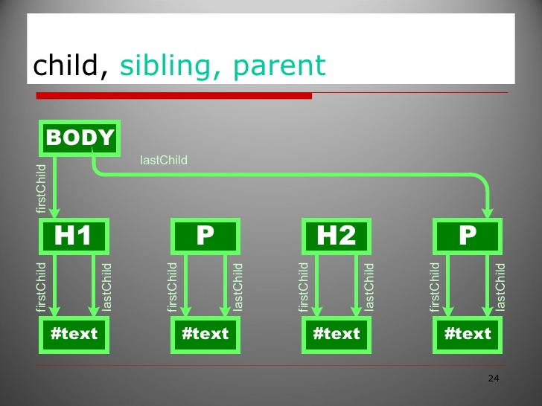
DOM
The Document Object Model (DOM) is a programming interface for HTML and XML documents, which can be modified with a scripting language such as JavaScript

Slide 21
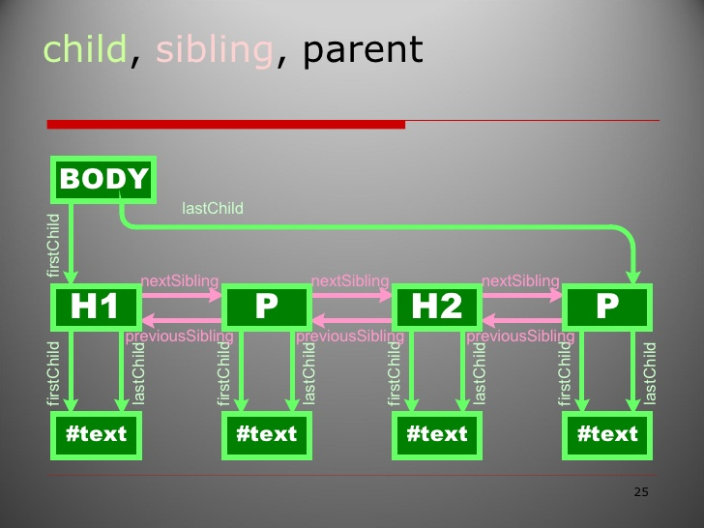
DOM

Slide 22
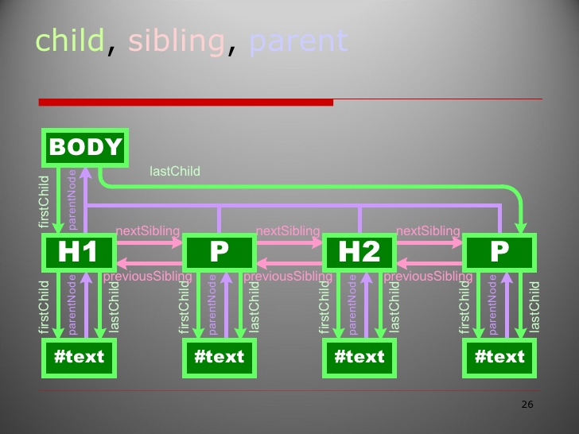
DOM

Slide 23
Document Object Model(DOM)
The Document Object Model (DOM) is a programming interface for HTML and XML documents, which can be modified with a scripting language such as JavaScript.
Methods :
write(), createElement( element ), getElementById( id name ), getElementsByTagName( tag name ), getElementsByClassName( class name ), querySelector( tag or id or class ),
querySelectorAll( tag or id or class ), appendChild( element ).
Properties :
firstChild, firstElementChild, lastChild, lastElementChild, removeChild, className, classList, childNodes.
DOM Events :
onclick, onmouseover, onmouseout, onkeyup, onkeydown, onchange.

Slide 24
Working with Form, JSON
Data Validation.
Create Element Dynamically, add Style Dynamically.
JSON(JavaScript Object Notation) :
JSON is a format for sharing data.
JSON.stringify()
JSON.parse()
JSON Data Types :
In JSON, values must be one of the following data types
a string, a number, an object, an array, a boolean, null
JSON values cannot be one of the following data types:
a function, a date, undefined

Slide 25
ES6 Features
let, const keywords.
Arrow functions.
Template strings(``).
Object and Array De-structuring.
…spread and …rest operators
spread turns array into a list of arguments
rest gather the remaining parameters into array.(turns list of arguments into array)
Promises.
ES6 Tooling : Babel.

